Slide 1
Prehospital Blood Transfusion Initiative Coalition
Full Coalition Meeting
January 20, 2025
Notes:
Welcome and thank you all for joining
If anyone had the invitation forwarded to them and they want to be added formally to the distribution list, please email me with your contact information.

Slide 2
Today’s Agenda
Introduction Dr. Jon Krohmer
  Informal meeting @ NAEMSP
Update on CMS Regulatory Changes Dr. Jon Krohmer
Non-profit incorporation Dr. Jon Krohmer
SS4A grants Dr. Scott Branney
Documentation guidance Chief Eric Bank
Scope of Practice Update Chief Eric Bank
Stakeholders Advocacy Meeting Dr. Jon Krohmer
Website updates Dr. Jon Krohmer
Update of Programs status – map Dr. Randi Schaefer
  Update information
Pillar Working Group Update group

Slide 3
CMS regulatory wording (eff 1/1/25)
Specifically, we are modifying the definition of ALS2 at §414.605 so that the list of ALS2 procedures now includes, as a new number 8, prehospital blood transfusion, which includes the administration of low titer O+ and O- whole blood; the administration of packed red blood cells; the administration of plasma; or the administration of a combination of packed red blood cells and plasma.
Encourage agencies to start billing for transfusions
May increase revenue
May encourage some insurers to reimburse
Will give us billing history
Will give us denial history

Slide 4
DOT SS4A program
Scott Branney, MD

Slide 5
SS4A
Safe Streets 4 ALL
A 5 year, 5 Billion grant program to reduce roadway deaths
They have already given out 3 billion, there are two years left
Based on the Safe Systems Approach:
  Safer People
  Safer Vehicles
  Safer Speeds
  Safer Roads
  Post-Crash Care
    “Enhance the survivability of crashes through expedient access to emergency medical care while creating a safe working environment for vital first responders and preventing secondary crashes through robust traffic incident management practices.”

Slide 6
Post-Crash Care
More of a push for this in the last 12-18 months
NHTSA data that 43% of eventual deaths are alive at first EMS contact
Advocating better resuscitation → Specifically whole blood programs

Slide 7
SS4A Program Details
Core element is a “Comprehensive Safety Action Plan”
  A plan to reduce deaths to zero by following the Safe Systems Approach
  Many cities and metropolitan planning organizations have these already
There are 2 buckets of funds available each year
  Supplemental planning and Demonstration
  Implementation grants
These are 20% Local Match Grants

Slide 8
Supplemental Planning and Demonstration
Comprehensive action plan without post-crash care that involves Whole blood
  This will be the majority of applicants
You would use whole blood to demonstrate its effectiveness
  Requires some research element
  Can be as simple as prospective observational results
  The deliverable would be supplemental planning for when the holder of the comprehensive action plan updates their action plan
May apply for $200,000 -- $10,000,000
Optimally should be completed within 3 years

Slide 9
Implementation Grants
These are only for Comprehensive Action Plans that already specify whole blood for post-crash care
  Few if any action plans
More money → $2,000,000 -- $20, 000,000
Longer time frame → up to 5 years
Much more competitive → about a 20% acceptance rate

Slide 10
Summary:
Next NOFO will come out in February, probably due late April, early May
For most groups the Supplemental Planning and Demonstation grant is the way to go
Align yourself with a group that has a comprehensive action plan
  Simple letter that you are working to advise the action plan will suffice
Good Luck, Happy Hunting!

Slide 11
Documentation Guidance
Chief Eric Bank

Slide 12
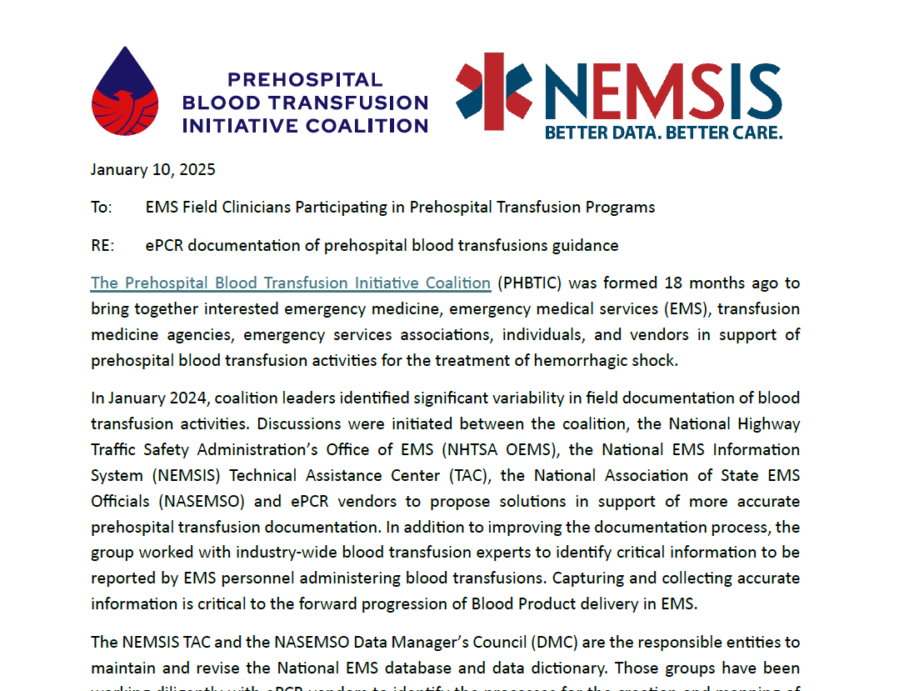

Slide 13
Scope pf Practice Update
Chief Eric Bank

Slide 14
US States allowing EMS Blood transfusion initiation (1-8-25)
YES
NO
Limited

Slide 15
Stakeholder Advocacy Discussions
Dr. Jon Krohmer

Slide 16
Stakeholder Advocacy Discussions
Purpose:
  Bring stakeholders together to discuss issues
  Identify talking points re blood transfusion reimbursement
  Not to conflict with other stakeholder issues
  Prior to stakeholder advocacy days
January 31, 2025 1000 ET - virtual meeting
February 26, 2025 1100 ET - virtual meeting
March 20, 2025 – 0800 – 1400 ET – in-person at the ACS WA HQ
  This meeting will be in-person only – no virtual option

Slide 17
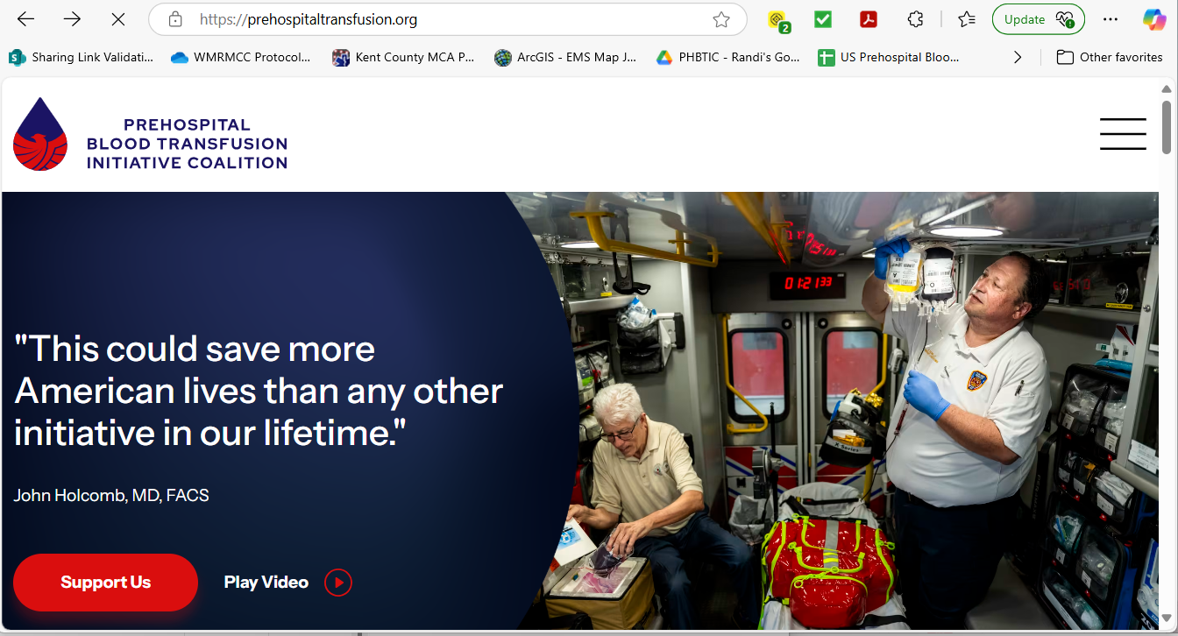

Slide 18
EMS Program Updates
Dr. Randi Schaefer

Slide 19
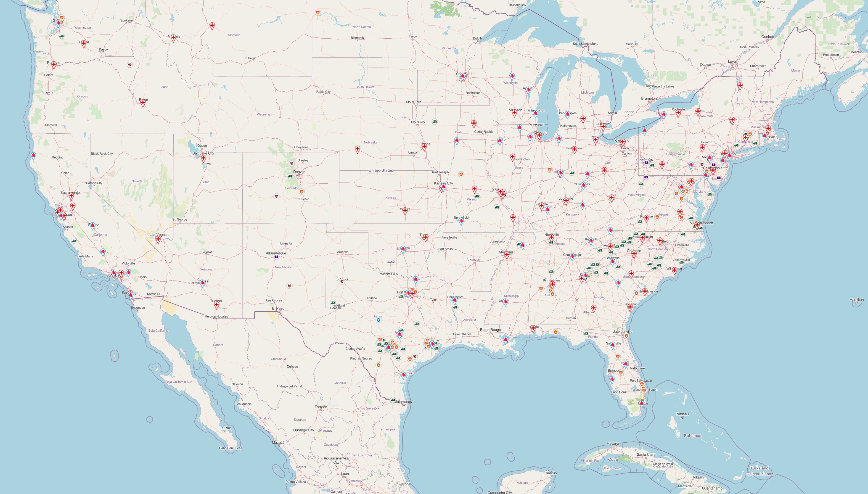
Who Is Doing Prehospital Blood?
200+ agencies
9-1-1 Ground EMS Blood Carrying Agencies as of October 2023
Notes:
181 Ground Agencies

Slide 20
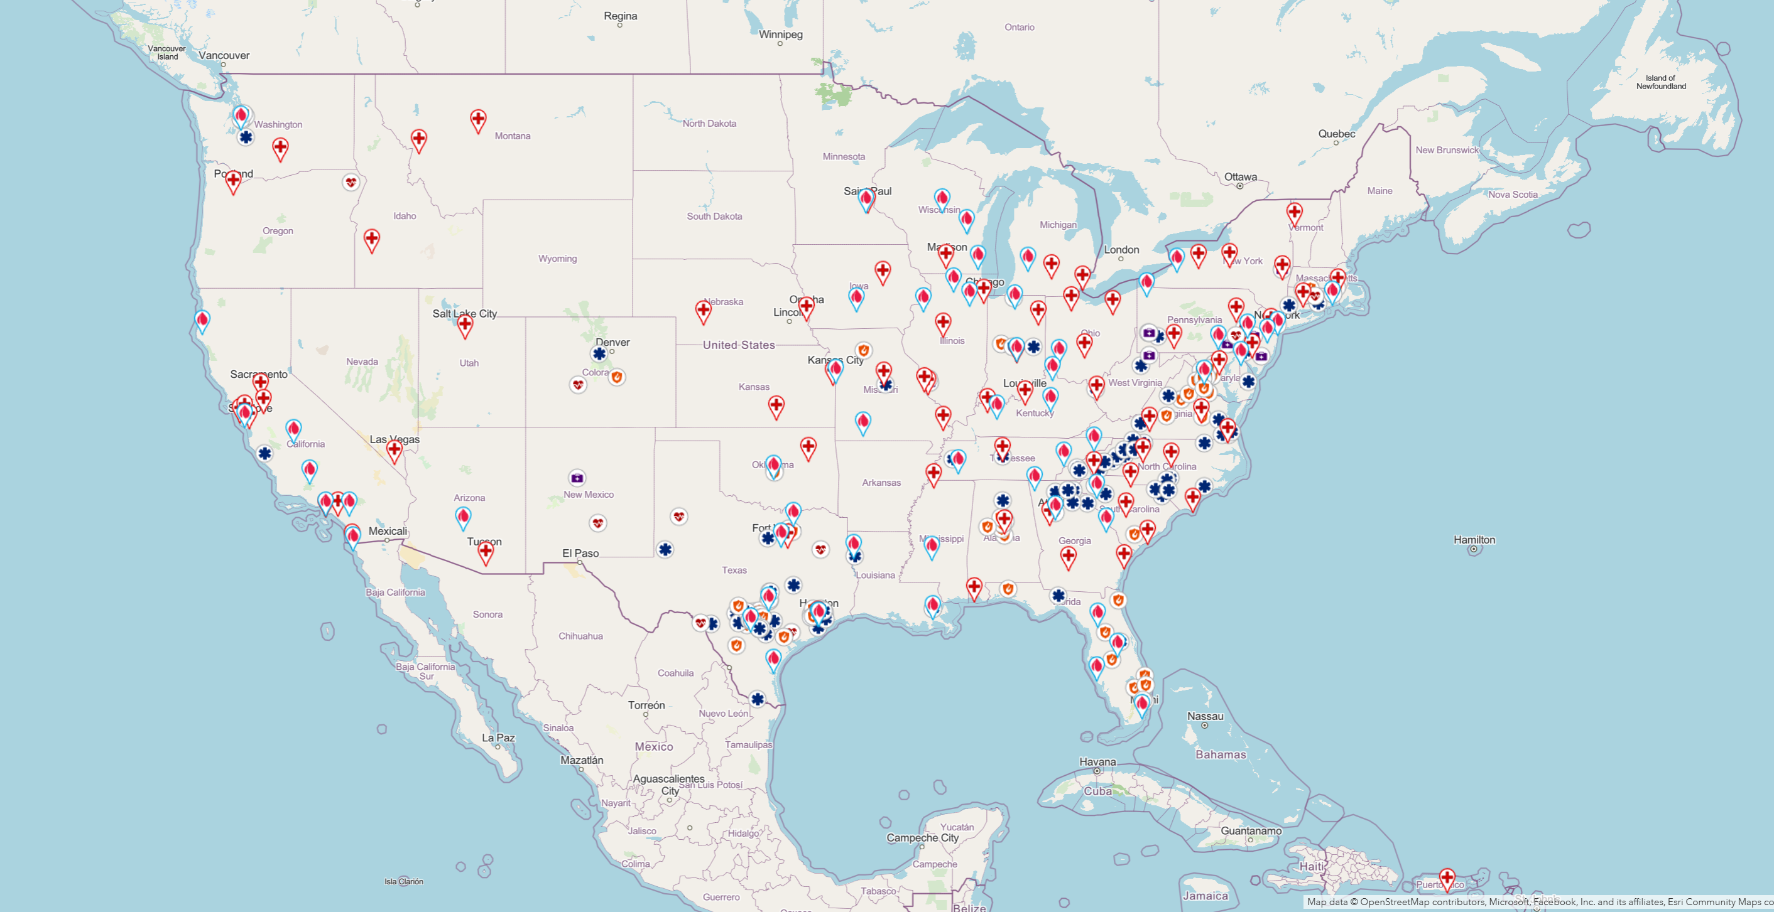
PHBTIC Interactive Map

Slide 21
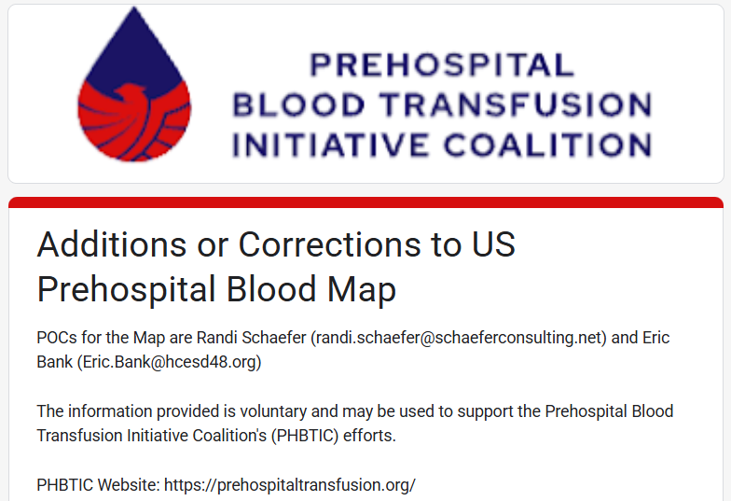
PHBTIC Interactive Map – program updates

Slide 22
Working Group Updates

Slide 23
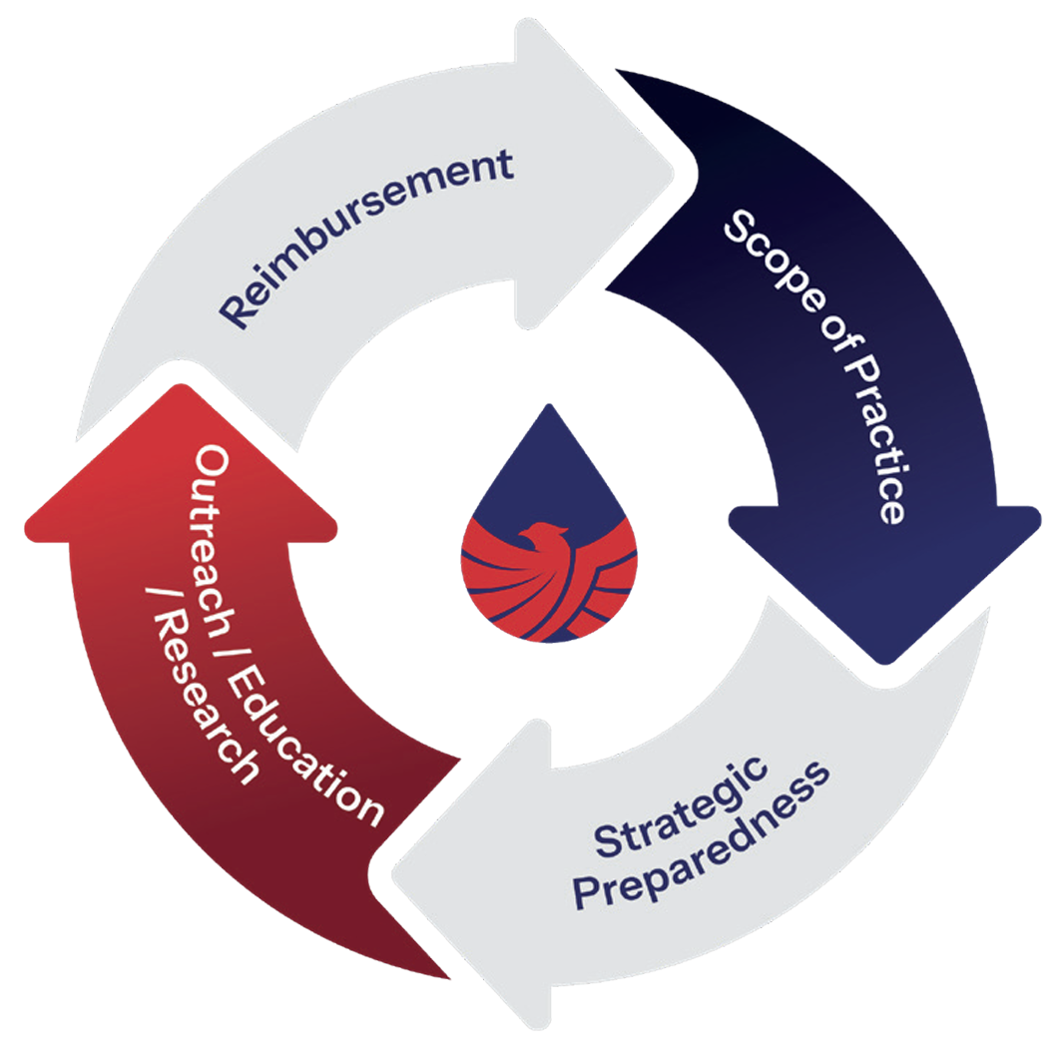
PHBTIC: Pillars Working Groups
(participants welcome!)
Strategic Preparedness
  Federal activities
Outreach, Program Development and Education and Research
  Resources and best practices
  Web references
Scope of Practice and Data
  Data discussion
  State survey update
Reimbursement and Advocacy
  Reimbursement Survey

Slide 24
Next meeting
March 17, 2025 1200 ET

